Slide 1
Baby Monitoring System
Group G:
Rad, Saeed, Vlad, Chimere, Riyadh

Slide 2
Product User Overview
Parents need to keep an eye on their baby at all times
Make sure their baby’s room temperature is no too cold or hot
Make sure the baby is not left crying in another room where they can’t hear him/her
See what s/he is doing (not swallowing LEGO pieces!)
Get notified if the baby has left a room or is not moving

Slide 3
How it’s Used
Parents monitoring their babies when around Loud appliances ->Can’t hear the baby
Working at home -> can’t have an eye on the baby
Parents are out when baby sleeping -> room gets too cold or baby leaves the room (phone app version)

Slide 4
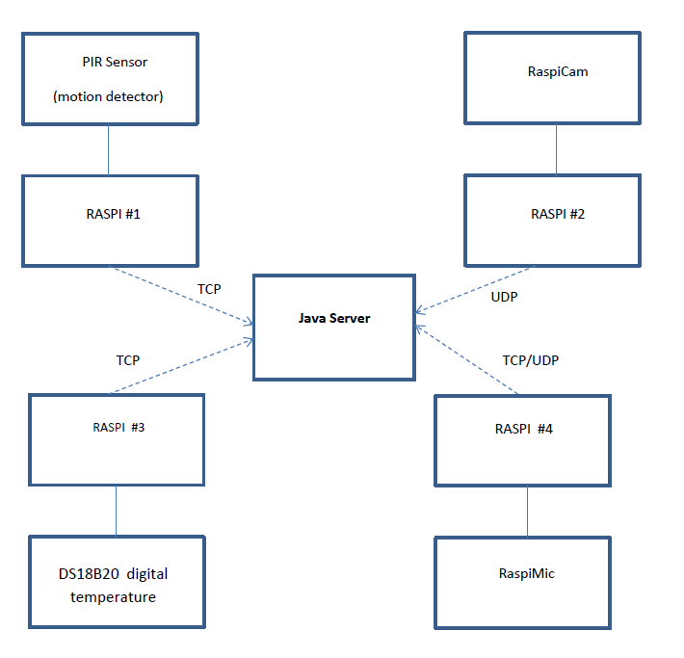
Component Diagram
Central Server in gathers information and displays the received data

Slide 5
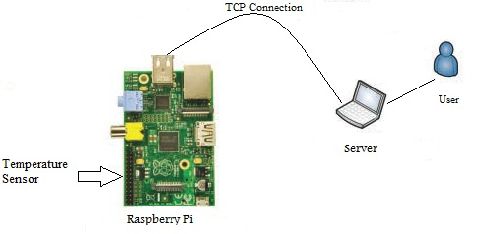
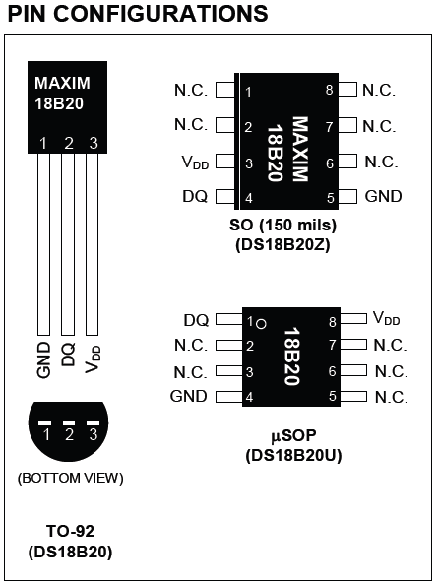
Digital thermometer
Figure1: General Overview
Figure2: DS18B20 PIN configurations
Function:
Monitor the temperature in the surrounding environment.
Specification:
1- Digital thermometer provides 9-bit to 12-bit Celsius.
2- Needs 1-Wire bus that by definition requires only one data line (and ground)
3- Its operating temperature range of -55°C to +125°C
4- is accurate to ±0.5°C over the range of -10°C to +85°C.

Slide 6
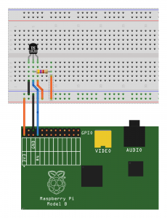
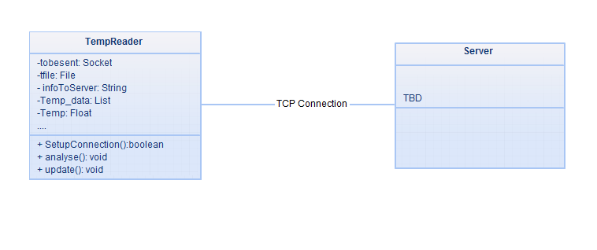
Figure3: Simplified Class Diagram
Figure4: Connecting the sensor DS18B20
Required Components:
1- Breadboard.
2- Jumper cables to connect it to the GPIO header.
3- DS18B20 Temperature Sensor.
Setup:
1- Pin 1 to be connected to P1-06 (Ground)
2- Pin 2 to be connected to P1-07 (GPIO4)
3- Pin 3 to be connected to P1-01 (3.3V)
4- A 4.7K resistor between Pin 2 and Pin 3.

Slide 7
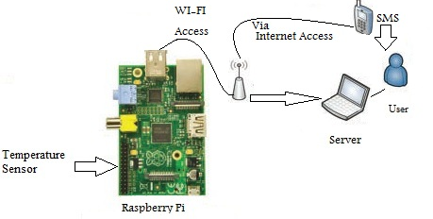
Future Improvements
Figure6: Future Improvements

Slide 8

RaspiMic
Function:
Transmits data on the sound from the baby’s room to the server being monitored by the parent.
Schematic Diagram:
Figure 1: Microphone to raspberry pi interface
Requirements:
Snowball iCE Microphone
Raspberry pi

Slide 9
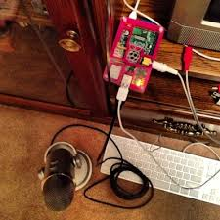
Microphone Specifications:
Sample/Word =44.1 kHz/16 bit
Frequency response=100Hz – 16 kHz
Compatible with PC or Macintosh
The Microphone connects to the Raspberry pi through a USB port. A representation of the connection is shown in the diagram below.
Figure 2: Representation of microphone to raspberry pi

Slide 10
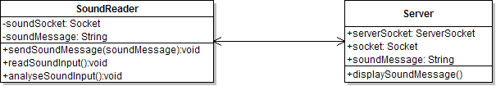
Class Diagram:
Figure 3: Class diagram of RaspiMic to Server interface
The implementation of the RaspiMic will progress in an incremental fashion. The sound read from the area is read in a periodic fashion. The periodic time interval for reading the sound is set through XML.
Incremental Progress:
Reading the sound and analyzing the waves to specify if the sound is alarming.
Reading the sound and transferring it through UDP packets to the server.
TCP

Slide 11
OV5647 Camera Specification
RaspiCAM
Name | Resolution | Frame per Second (fps)
 | Width x Height
5 Mega pixel | 2592 x 1944 | 15
1080p (Full High Definition) | 1920 x 1080 | 30
960p (Quarter High Definition) | 1280 x 960 | 45
720p ( High Defitnition) | 1280 x 720 | 60
VGA (Video Graphic Array) | 640 x 480 | 90
QVGA (Quarter Video Graphic Array | 320 x 240 | 120
Table 1: Raspicam Image Transfer Capability [1] [Raditya Budianto]
Raspicam Specification:
Current draw: [1]
Idle: 117 mA
Active: 268 mA
Input Voltage: 3.3 V [1]
Connect with Raspberry Pi via S5 slot (CSI-2 Camera Serial Interface port , 15-pin flat flexible connector)
[1]https://www.sparkfun.com/products/11868. Accessed 11 October 2013.
[2]http://www.designspark.com/blog/time-lapse-photography-with-the-raspberry-pi-camera. Accessed 11 October 2013.

Slide 12
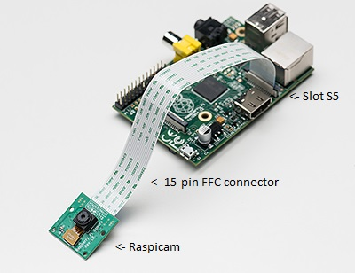
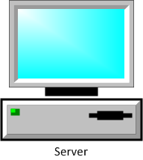
Video Interface System
Figure 1: Raspicam-to-Raspberry Pi Hardware Connection [Raditya Budianto]
Figure 2: Video Interface System of Baby Monitoring Project[3][Raditya Budianto]
[3] http://www.adafruit.com/products/1367. Accessed 11 October 2013.

Slide 13

Video Recording System Work Plan
Figure 3: Video Recording System Work Plan for Baby Monitoring Project [Raditya Budianto]

Slide 14
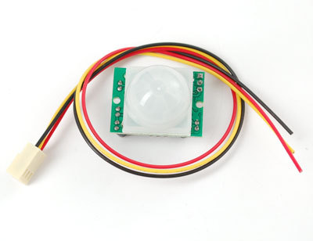
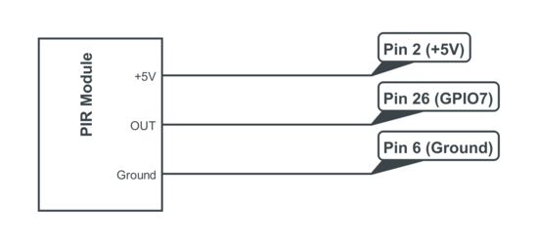
PIR motion sensor
Figure 4: PIR motion sensor [4]
Figure 5: PIR motion sensor pin connection [5]
Function:
Monitors movement in the room.
Sets the OUT pin high if movement
was sensed
Specification:
Input voltage: 5V
Output voltage: 3.3V
Sensing range: 7 meters/120degree cone
[4] http://learn.adafruit.com/assets/3923
[5] http://www.raspberrypi-spy.co.uk/wp-content/uploads/2013/01/pir_module_circuit_1.png

Slide 15
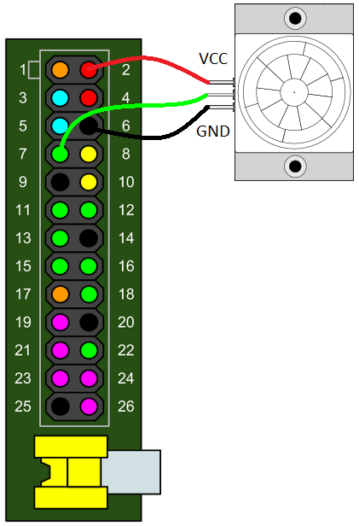
Materials
Raspberry pie
PIR sensor
Breadboard
PI cobbler
Jumper wire pack
or
Raspberry pie
PIR sensor
Gertboard
Figure 6: An example of PIR set-up [6]
[6] http://blogs.arcsoftwareconsultancy.com/pi/files/2013/10/pir_wiring.png

Slide 16
Raspberry pi PIR sensor system
Raspberry PI
Java Server
Client
stringMessage
Server
motionDetected
SensorRead
HistoryXml
= TCP connection
Figure 7: Raspberry pie to Java server interaction

Slide 17
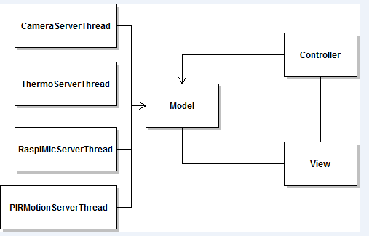
The Java server
Multi-Threaded with MVS

Slide 18
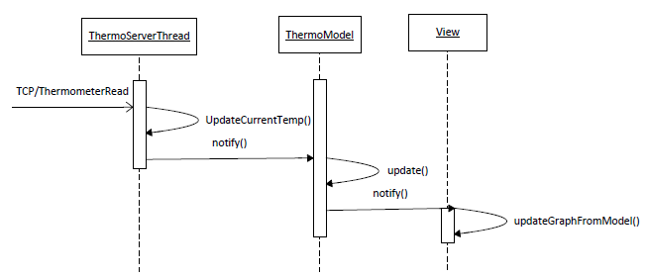
Sample process

Slide 19
Challenges and solutions
Simple Observer Pattern vs. MVC:
Adding data backup process button
sensor stop/start signals through GUI
Use Of XML:
Use XML as a configuration file for hardware setup (on Raspi(s))

Slide 20
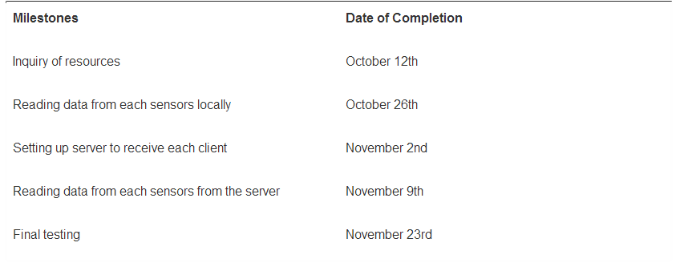

Milestones

Slide 21
Questions? Feedback? Suggestions?

